Slide 1
Text Mining: Sentiment Analysis on Data Science Job Descriptions
Data 607
Eunice Ok

Slide 2
Objective
Perform exploratory sentiment analysis on data science job descriptions to see if there are any interesting patterns and implications for a job search down the line. Try to answer: when job descriptions sound amazing should I trust it is amazing?
Finding
A sexy job description != the “best” role

Slide 3
Overview
Applications
To identify affective states and subjective information, esp VOC
Marketing to customer service to clinical medicine contexts
Two approaches to analyzing sentiment
Lexicon-based
Machine Learning
Today’s approach
Lexicon-based - uses pre-existing sentiment lexicon containing words assigned a polarity score

Slide 4
Preprocess aka Lexicon Normalization
Apply the following steps on job descriptions:
Tokenize to create a corpus
Remove stopwords
Lemmatize

Slide 5
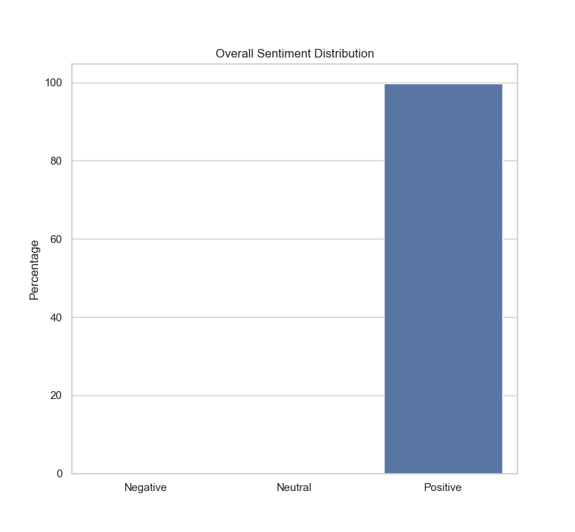
Analyze for sentiment
Use Python NLP package called NLTK’s Vader Sentiment Analyzer
Rank a dataset containing 433 unique job descriptions as positive, negative or neutral using a lexicon of positive and negative words
Aggregate scores into a compound sentiment score
Bucket into Negative, Neutral and Positive labels at key thresholds (0.2 and -0.2)
The job descriptions were overwhelmingly positive in sentiment with slight variations by company, location, and industry
*Tutorial used: https://www.learndatasci.com/tutorials/sentiment-analysis-reddit-headlines-pythons-nltk/

Slide 6
Most Positive Examples
#3 MetroPlus (score 0.99) says...
#20 Atlassian (score 0.99) says...
By helping quality brands grow, not only can we assist our clients to achieve their dreams, but we make the market a better place for consumers. Each member of our team shares in the joy and responsibility of making the ecommerce world a better place. Do you love data? Do you love to experiment? Do you love FACTS?... SixLeaf is looking for someone who is passionate about these things… Other benefits include: Learn Something New, Make More Money, Expand Your Skillset....Overall, you will walk away from this job a more capable and productive individual...you'll be shining a light on the otherwise dimly lit world of ecommerce, and specifically Amazon, data.
...You love wrangling messy data into an elegant solution, and helping others understand the power of their data. This role is a chance to have a huge impact on how millions of users collaborate. Do your best work in a fun, respectful, and supportive environment...with a passion for deriving insights from data and telling a story. Atlassian is highly collaborative and yes, fun! To support you at work (and play) we offer some fantastic perks...Driven by honest values, an amazing culture, and consistent revenue growth, we’re out to unleash the potential of every team...looking for people who are powered by passion and eager to do the best work of their lives
Notes:
# 1
For more than 30 years, MetroPlus has been committed to building strong relationships with its members and providers to enable New Yorkers to live their healthiest life.
Position Overview
The desired Senior Data Scientist candidate will lead the design, development, and management of advanced analytics solutions that innovate and help us make smarter decisions to deliver even better care to our members...
The successful candidate can work both independently with little supervision or guidance & collaboratively with many stakeholders and SMEâ€™s, leading advanced data analysis and data modeling projects, from project design & iteration w/ internal clients, to the reception / processing of data and analyses and or modeling, and to the delivery of final reports/presentations, communication of results and implementation support. Teamwork is essential as this role requires collaborating with various subject matter experts, management, and other industry leaders. This position requires an analytical-minded individual who enjoys and thrives working in a fast-paced, nebulous, challenging, but rewarding environment.
Comprehensive knowledge of healthcare insurance industry, products, systems, business strategies and products is highly desired. Strong understanding of Quality, Care and Utilization Management and Measurement reporting is also highly preferred, along with experience in healthcare data sets.
Job Description
Analyze healthcare data and using quantitative methods to create actionable and timely information across the Medical Management teams, and up and down the MetroPlus business hierarchy.
Create meaningful data visualizations & presentations to communicate findings and relate them back to how they create business impact.
Develop sophisticated algorithms / predictive models to evaluate scenarios to make predictions of future outcomes, and or evaluate future impact of changes
Apply data mining techniques to create statistical models and solutions detecting patterns, relationships across available data sets (e.g. NHWS, Electronic Health Records (EHR), claims data, or these data sets linked together) using machine learning methodologies & tools.
Build high performing predictive systems that empower cross-functional Medical Management teams (and MetroPlus at large) to more effectively, efficiently target care & utilization management initiatives across our membership population and provider networks
Lead the design, development, and delivery of proactive linked data studies w/ internal teams and SMEâ€™s; direct or perform these linked data studies and build out studies using new linked data sets. Drive conversations with internal stakeholders and leaders on product design, data specification, model implementations
Provide thought leadership on advanced statistical / mathematical analyses and related strategic insights to various internal stakeholders and key decision makers.
Tests new statistical analysis methods, software and data sources for continual improvement of quantitative solutions. Drive proof of concept tests of new data, software and technologies.
Hire and mentor a small team of junior data scientists; also provides guidance to other Health Analytics team members where relevant
Collaborate with other Health Analytics team members and other departments & SMEâ€™s to understand company needs and devise possible solutions including data integrity / data governance solutions to remove joint obstacles to timely and high-quality data analytics
Optimize joint development efforts through appropriate database use and project design
Assures compliance with regulatory and privacy requirements during design and implementation of modeling and analysis projects. Communicate, as needed, with the NYS or NYC Departments of Health on relevant analyses
Perform other duties as required
Minimum Qualifications
Masterâ€™s or PhD degree in Statistics, Biostatistics, Math, Computer Science, Health Economics, Epidemiology, Healthcare Informatics, or Data Science with additional coursework in machine learning, predictive modeling and data management.
5+ yearsâ€™ practical experience with SAS, SQL, ETL, data processing, and database programming
8+ years related experience with healthcare data analytics, statistical analysis, predictive modeling, machine learning techniques, and visualization tools.
Excellent problem solving skills, critical thinking and conceptual thinking abilities
Strong organizational, management and leadership skills
Substantial experience in SAS or SQL, and other programming languages
Advanced, in-depth specialization in mathematical analysis methods, predictive modeling, statistical analyses, and big data technologies such as Python, R, Hadoop or Hive.
Strong ability to communicate technical, statistical concepts and implications to non-technical teams and leaders across the business and in the external health care environment.
Extensive background in data mining and statistical analysis and skills, such as distributions, statistical testing, regression, etc.)
Mastery of various data structures and common methods in data transformation
Excellent pattern recognition and predictive modeling skills
Experience with data visualization tools
Excellent communication skills
Desired Skills
Extensive knowledge on health care industry, products, systems, business strategies and products and experience in healthcare industry is highly desired
Hands-on experience doing statistical analysis in healthcare is extremely preferred, along with experience using real-world data (preferably EHR and claims data)
Strong expertise in statistical modeling techniques such as linear regression, logistic regression, survival analysis, GLM, tree models (Random Forests and GBM), cluster analysis, principal components, feature creation, and validation.
Strong expertise in regularization techniques (Ridge, Lasso, elastic nets), variable selection techniques, feature creation (transformation, binning, high level categorical reduction, etc.) and validation (hold-outs, CV, bootstrap).
Professional Competencies
Integrity and Trust
Customer Focus
# 2
Our mission is to help as many brands as possible scale to the point where they are household names. And our goal is to be the very best at it. By helping quality brands grow, not only can we assist our clients to achieve their dreams, but we make the market a better place for consumers. Each member of our team shares in the joy and responsibility of making the ecommerce world a better place. Do you love data? Do you love to experiment? Do you love FACTS?
SixLeaf is looking for someone who is passionate about these things. Someone who, with the fervor of an investigative reporter, wants to get to the inner workings of a thing. Someone who doesn’t care for hype and is mostly concerned about the truth.
If you have a passion for research and technical writing, this may be the perfect position for you. Other benefits include:
Learn Something New: It is very unlikely you’ve ever worked on a project quite like this. You’ll be exposed to a fascinating and challenging new world where you will be learning about an incredibly exciting industry that is still in its infancy.
Make More Money: To put it bluntly; we are generous. As a startup, we don’t quite have each benchmark that determines bonus structures and pay increases set in stone yet, but we have consistently been extremely giving. We’ve given a bonus each year for the Christmas season. We’ve given raises after each 90-day probationary period. We also regularly increase pay based on exemplary performance.
Expand Your Skillset: You’ll be exposed to people from around the world who each bring a unique set of skills to the table. You’ll also be learning the intricacies of a relatively new industry to the SAAS space, which will require expansion on current knowledge. Overall, you will walk away from this job a more capable and productive individual.
You'll be responsible for creating experiments and finding the right data combinations to draw logical and educated conclusions. By outlining parallels and correlations, you'll be shining a light on the otherwise dimly lit world of ecommerce, and specifically Amazon, data.

Slide 7
Least Positive Examples
#1 Vivifitech (score 0) says...
#3 Ganit (score 0.27) says...
$65 - $70 an hourContractRequirements: Data Science, Machine Learning, Python, R, SCALATerm: 1 yearLocation: Dallas, TexasJob Type: ContractSalary: $65.00 to $70.00 /hourContract Renewal:Possible
Location: USA multiple locations
2+ years of Analytics experience
Understand business requirements and technical requirements
Can handle data extraction, preparation and transformation
Create and implement data models

Slide 8
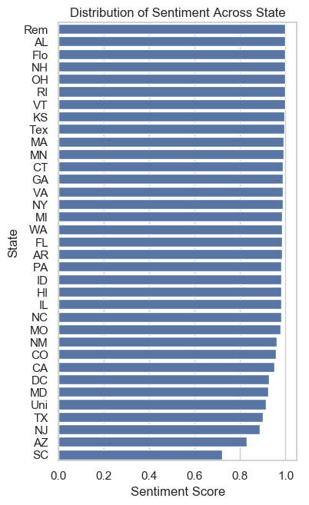
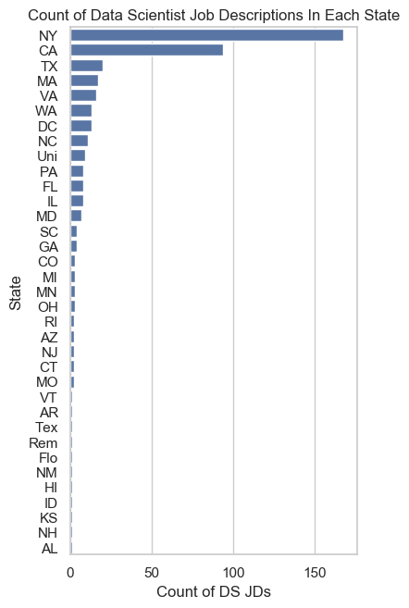
States
States such as NY, CA, and TX have many more data scientist openings than in other states
States that have fewer openings tend to have job descriptions with more positive sentiment scores, on average.
The lesson: don’t assume sexy job descriptions = better job!
Companies in less central locations may be trying to compensate by drafting more enticing job descriptions to attract candidates.

Slide 9
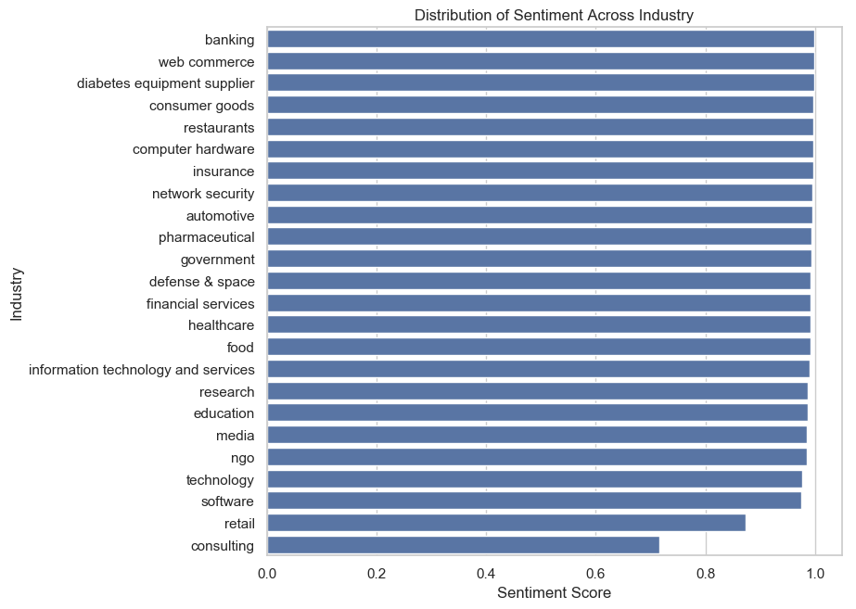
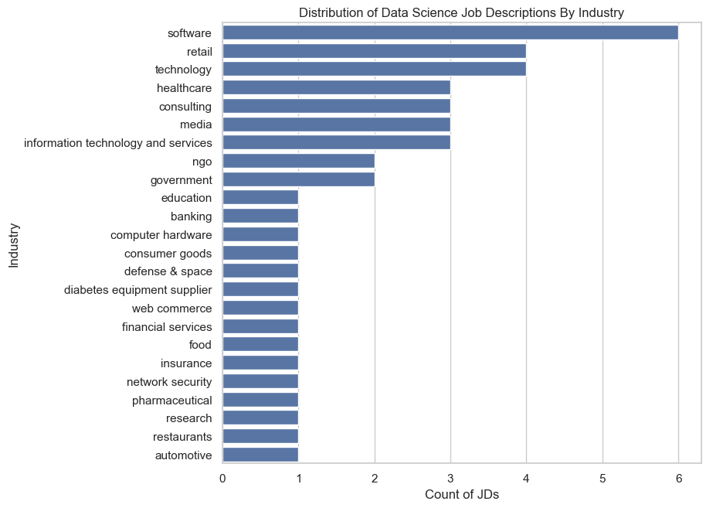
Industry
Manually tagged, therefore contains a smaller subset of 45 unique companies
Are certain industries trying harder because they’re newer, less analytically mature, etc. and trying to compensate?
Interesting variety of industries represented here

Slide 10
What next?
Would other approaches be better at classifying/predicting sentiment? e.g. instead of bag-of-words, using bigrams/trigrams and either building my own lexicon or taking a machine learning approach
With the current approach, how much does the length of a job description contribute to a sentiment polarity score?
If the ultimate goal is for us to predict if we will be happy with a potential future role, what are the variables that really matter?
What is the relationship between a company’s job description’s sentiment score and company reviews? And hire rates?
How big is the variance of sentiment scores of across jobs in the same company?
Outside Is there gender bias in terms of how job descriptions are worded?

Slide 11
Packages Used
import pandas as pd
import numpy as np
import matplotlib.pyplot as plt
import seaborn as sns
sns.set(style='whitegrid')
import nltk
nltk.download('vader_lexicon')
from nltk.sentiment.vader import SentimentIntensityAnalyzer as SIA
from nltk.tokenize import word_tokenize, sent_tokenize
from nltk.corpus import stopwords
from nltk.stem.wordnet import WordNetLemmatizer

Slide 12
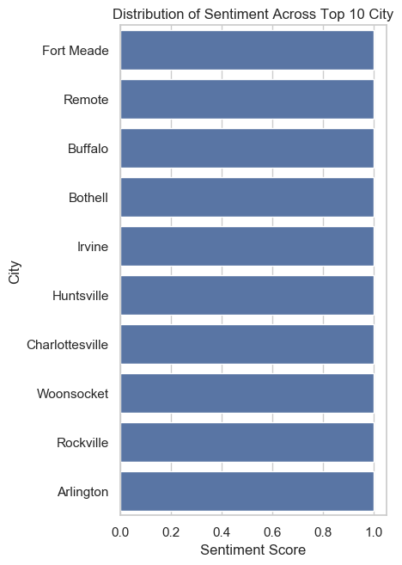
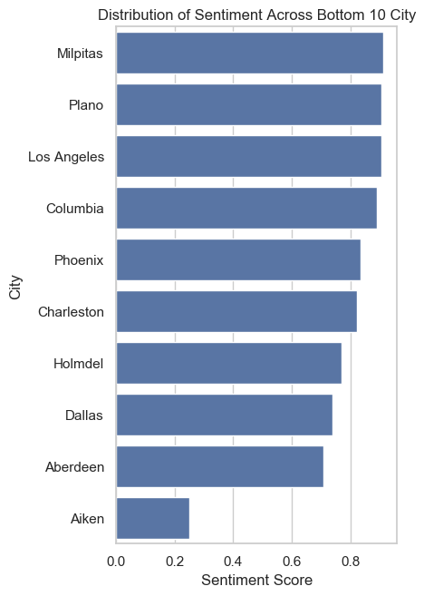
Cities

